Slide 1
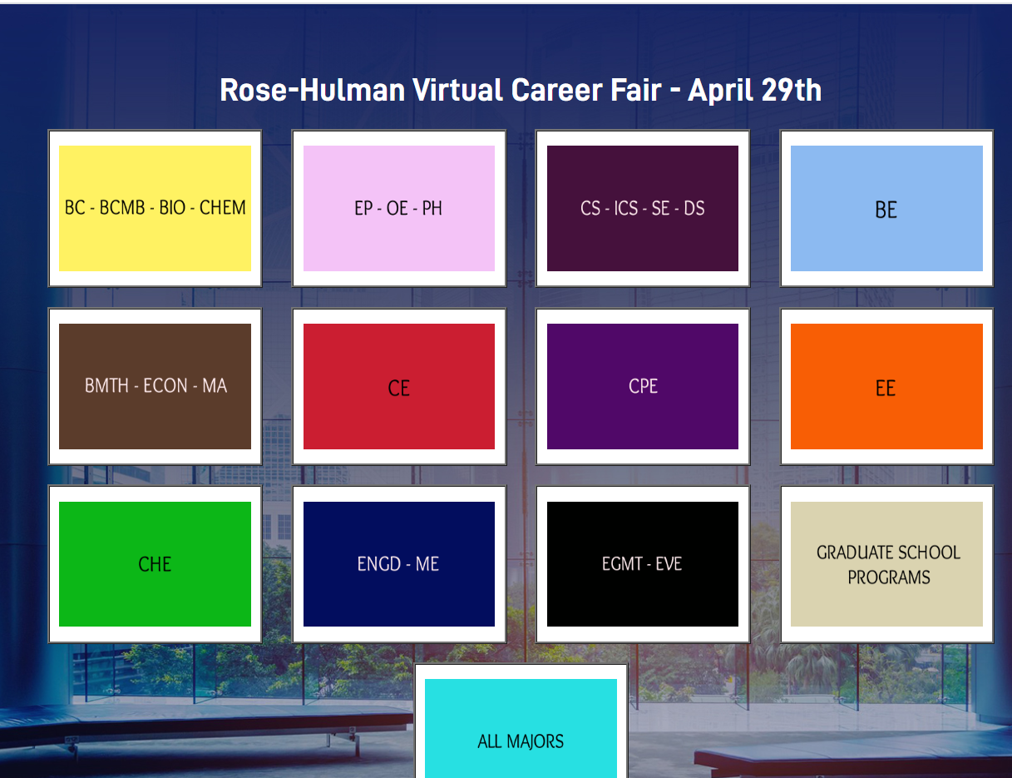
Virtual Career Fair Training Guide for ROSE-hulman students

Slide 2
Best Practices for a virtual career fair
Pre-Event
During the event
Post event
Register and upload your resume
Make sure you test on your computer/browser to make sure you know how to use it
Chrome works best
Log in on the day of event
Go into your major and look at all company hiring rooms
Once you go into a company hiring room, look at all their information to make sure it is what you are looking for.
Look at all companies not just the big name companies
Take notes on which companies you spoke with and applied to
Follow up companies
Connect on Linkedin with the people you spoke with

Slide 3
https://www.premiervirtual.com/event/register/rose-hulman
Enter contact information and upload your resume
Hit register button
This takes you to next page where you enter lobby

Slide 4
Click on your Major

Slide 5
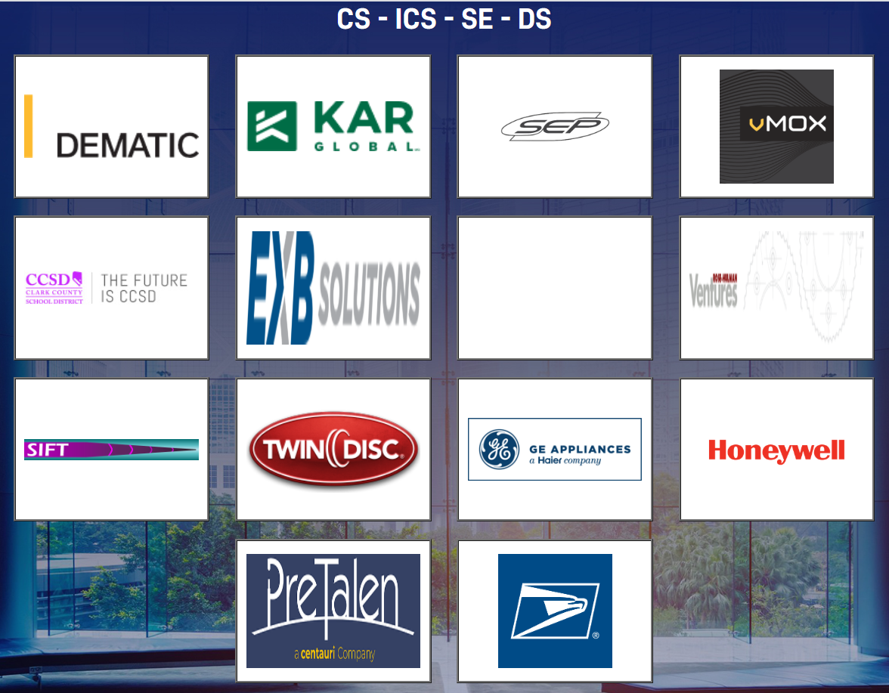
Click on company logo to get
to their hiring room

Slide 6
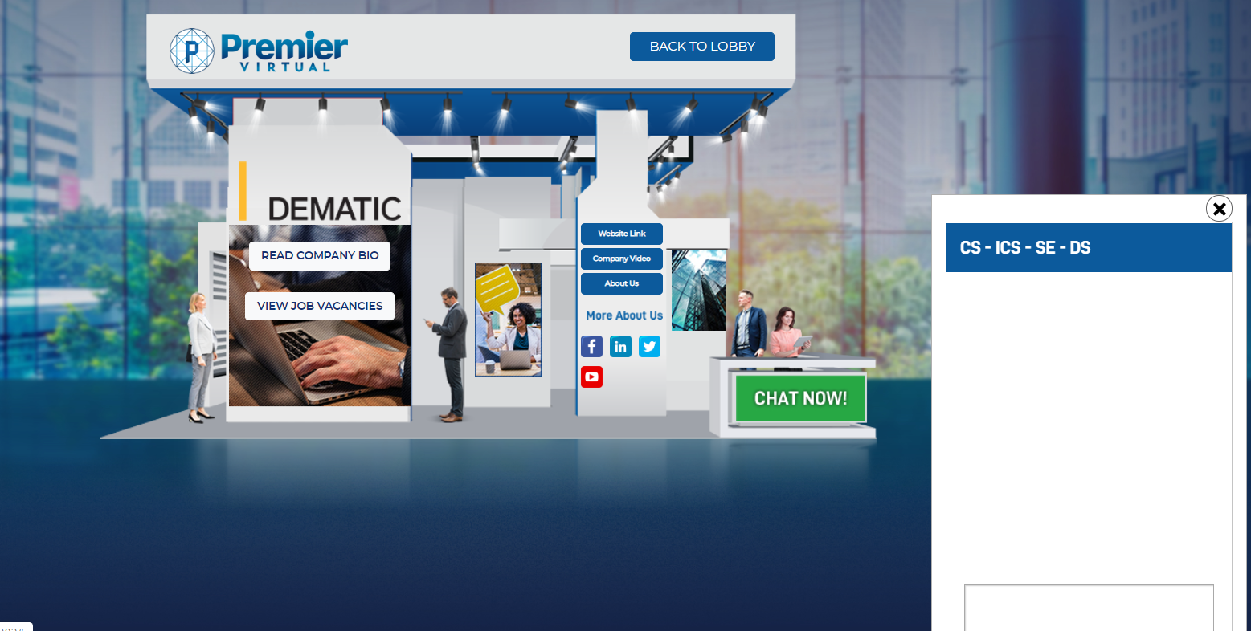
Click on company bio and job vacancies. You can view jobs and apply here.
Research company and their social media links
Start a conversation with recruiters if you have more questions
Go back to the lobby and view other companies

Slide 7
Thank you for participating
in the
Rose-Hulman Virtual Career Fair

